Slide 1
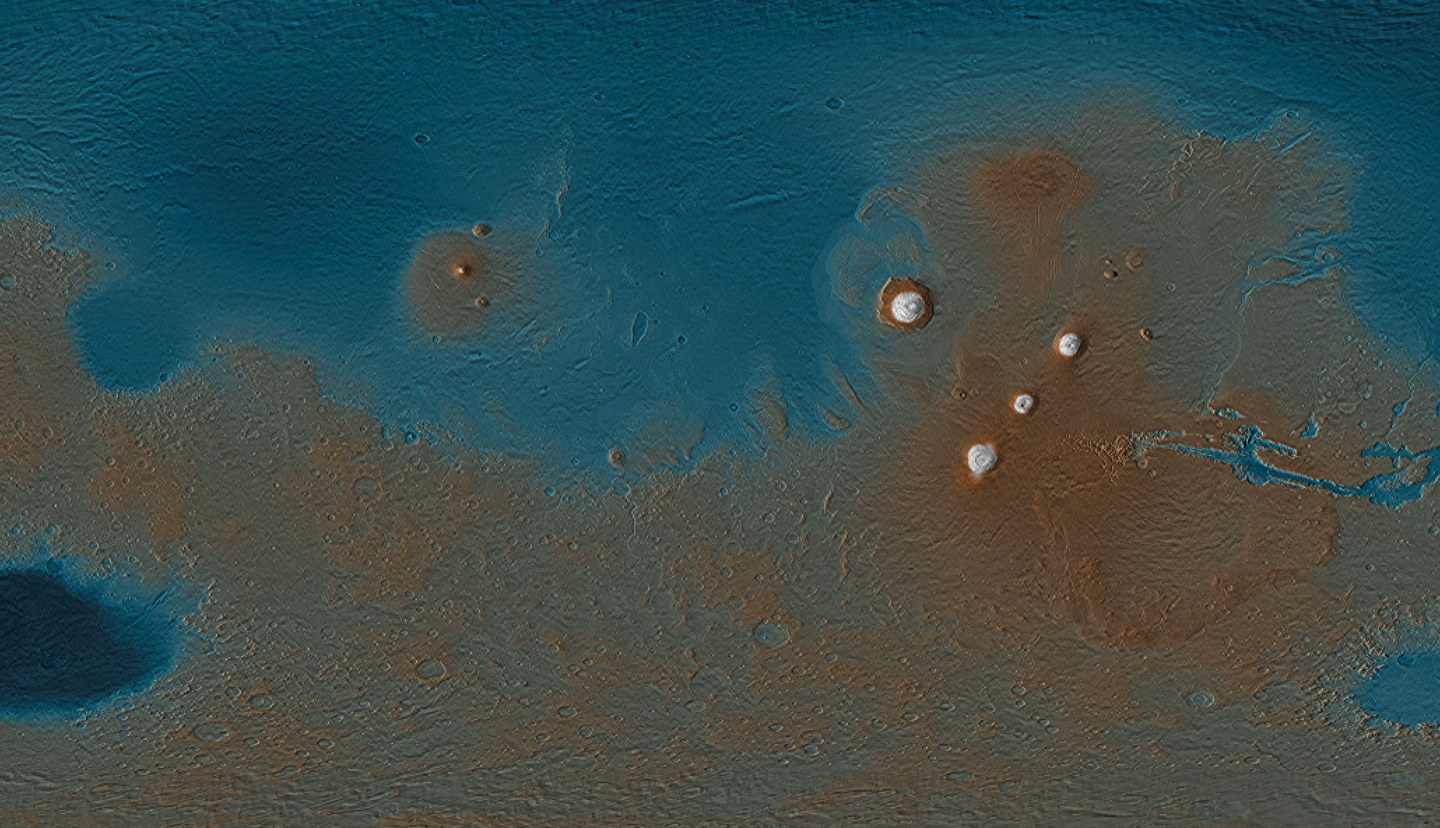


Investigating Ancient Inverted Valley Networks on Mars
Hannah Zigo
Department of Astronomy and Planetary Science
Northern Arizona University

Slide 2
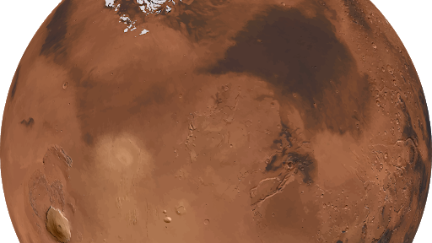
Background
Cold and sad!
Life?
Habitability/colonization
Notes:
Mars is a cold dead planet
Had a lot of water, where did it go?
Was it ever habitable? Potential for life?
Can we ever live in Mars again?
Understanding the past Martian surface will help us better answer these questions…

Slide 3
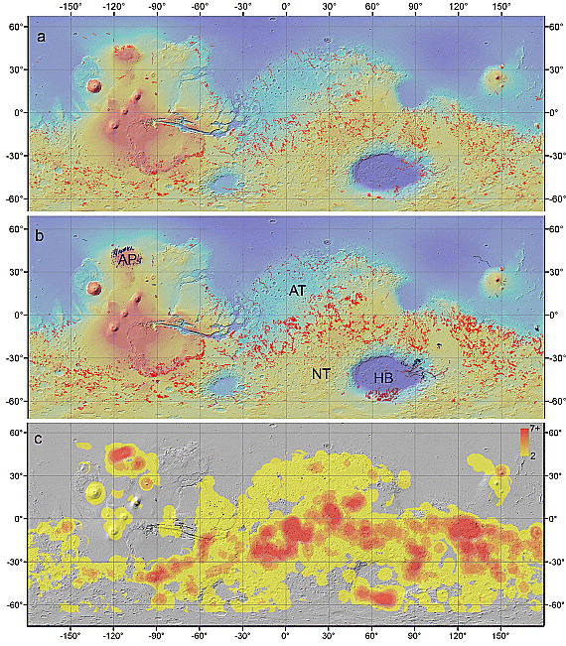
Valley Networks
Noachian ~4 billion years old
Carr 1995
Notes:
What are valley networks?
Valley Networks are features created by aqueous conditions on Mars, carving out numerous valleys on the surface on Mars.
This indicates a past of fluvial activity on Mars

Slide 4
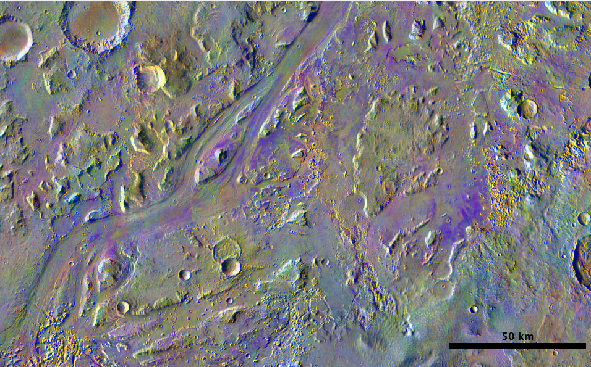
Olivine
Chemical alteration
DCS bands 8 (11.79 μm), 7 (11.04 μm), and 5 (9.35 μm)
Low emissivity near 11 μm
Notes:
What is olivine?
Why do we care?
What does it mean?
Olivine is all over mars, mainly due to volcanism
Olivine is a soft mineral, mainly being weathered away by water processes
The extensiveness of Olivine on the surface of Mars indicates that there hasn’t been any active processes happening to weather away the Olivine
In this DCS band combination, olivine ap- pears as a bright purple/magenta color on the surface duetoitsrelativelylowemissivitynear11μ! m,making it easily identifiable in these products

Slide 5
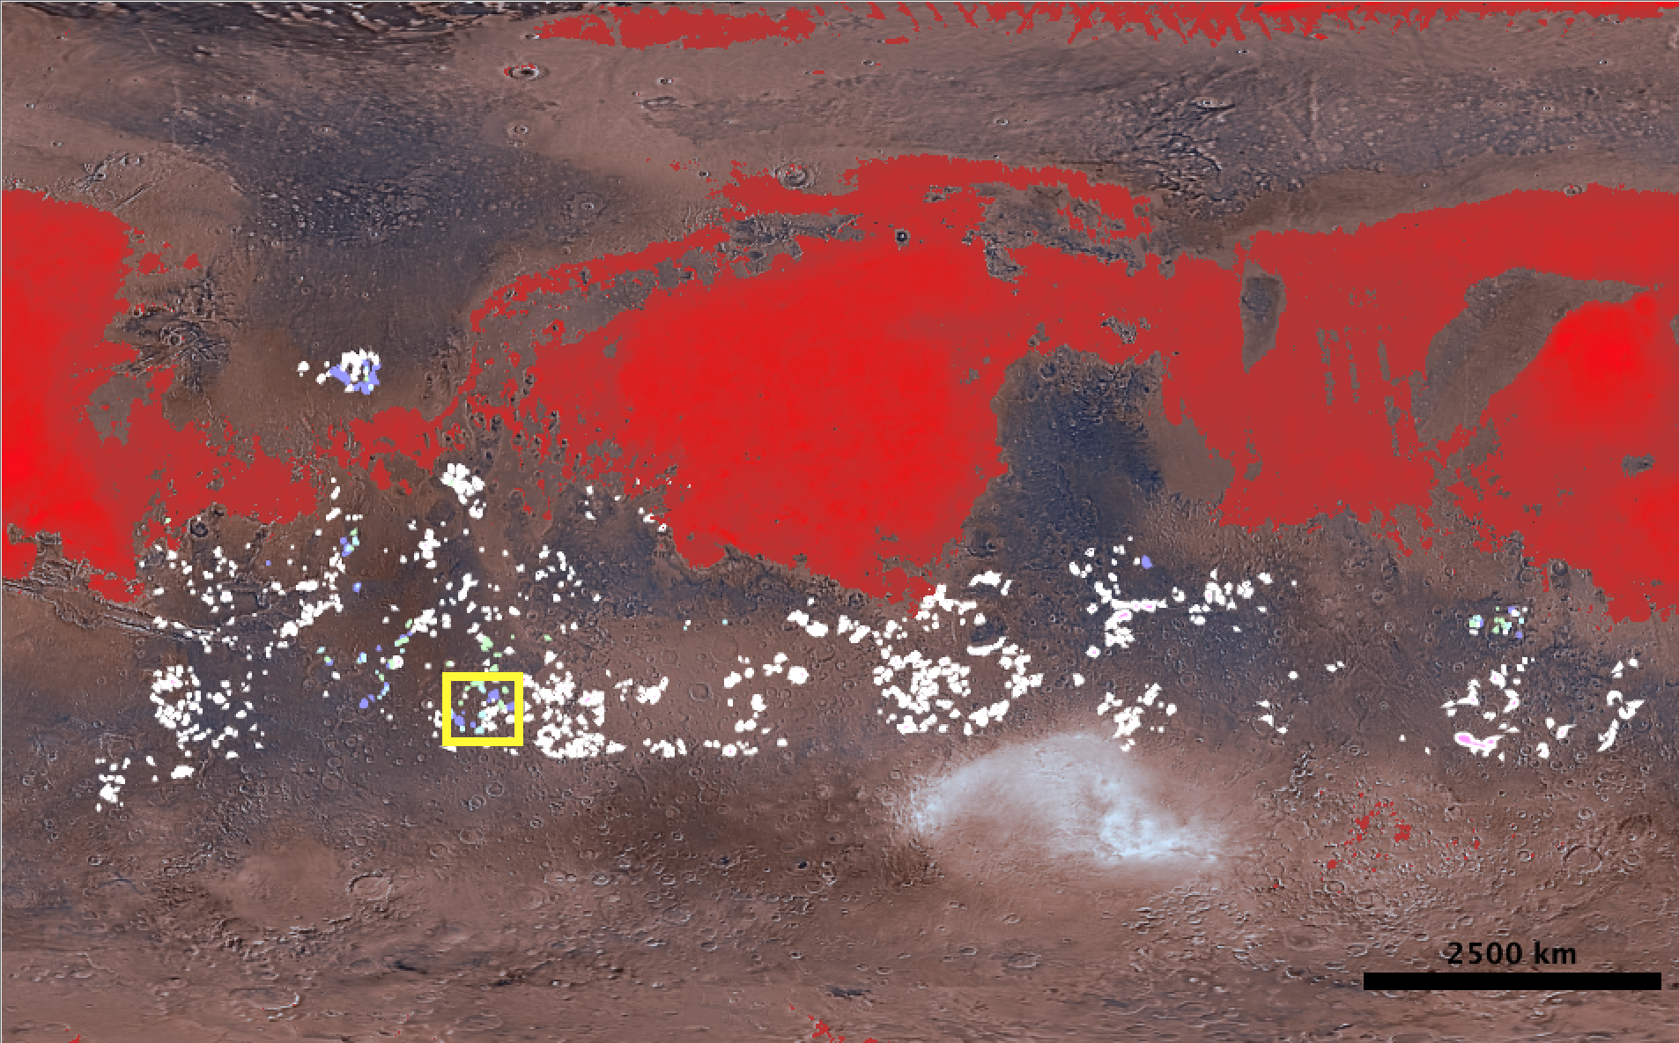
What have we done?

Slide 6
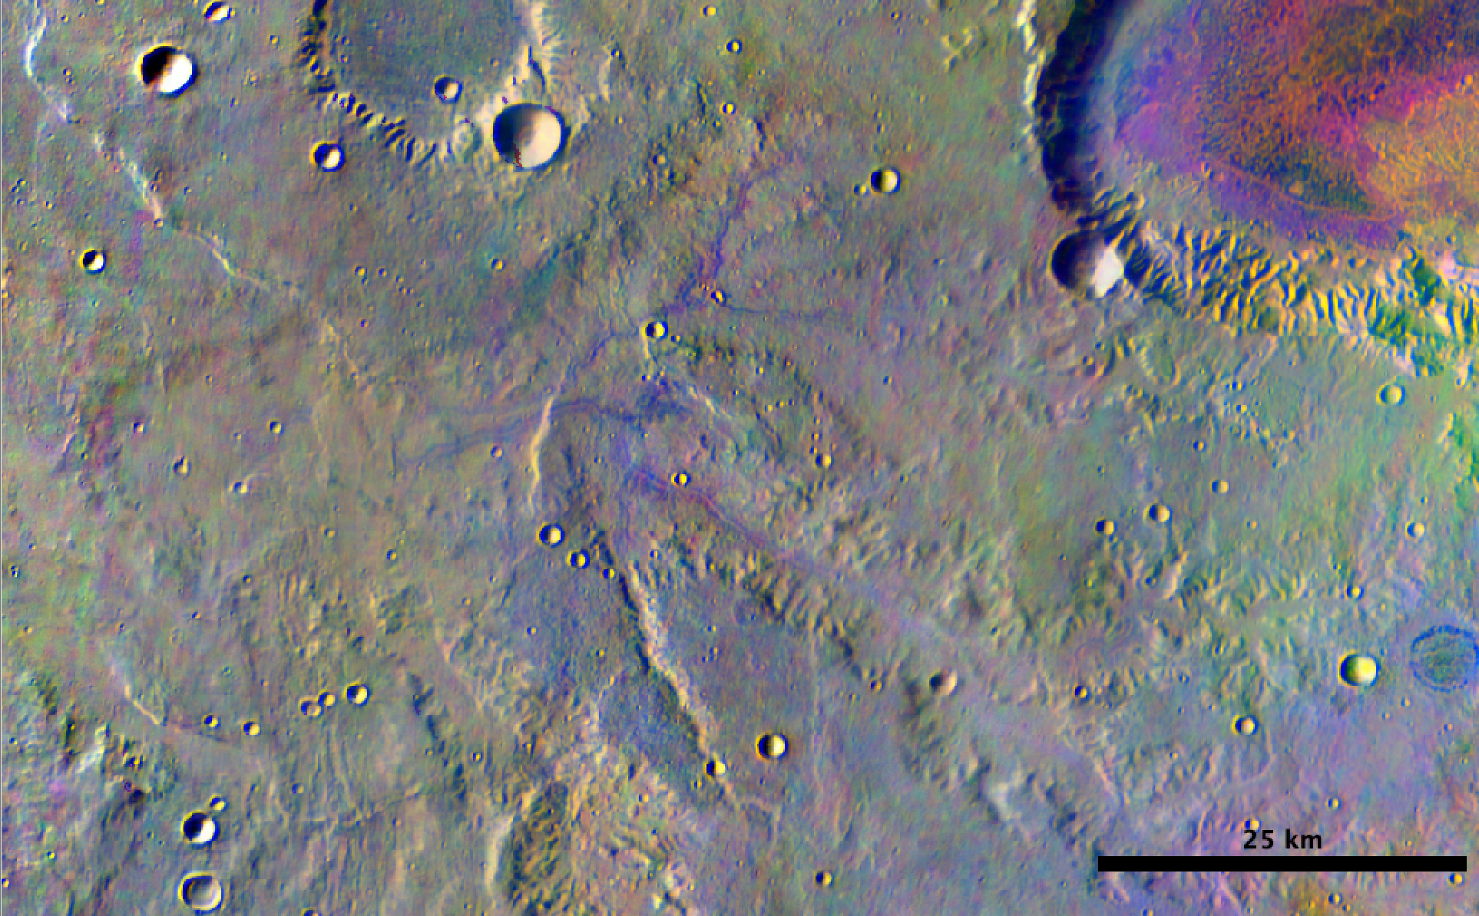
What we’re investigating

Slide 7
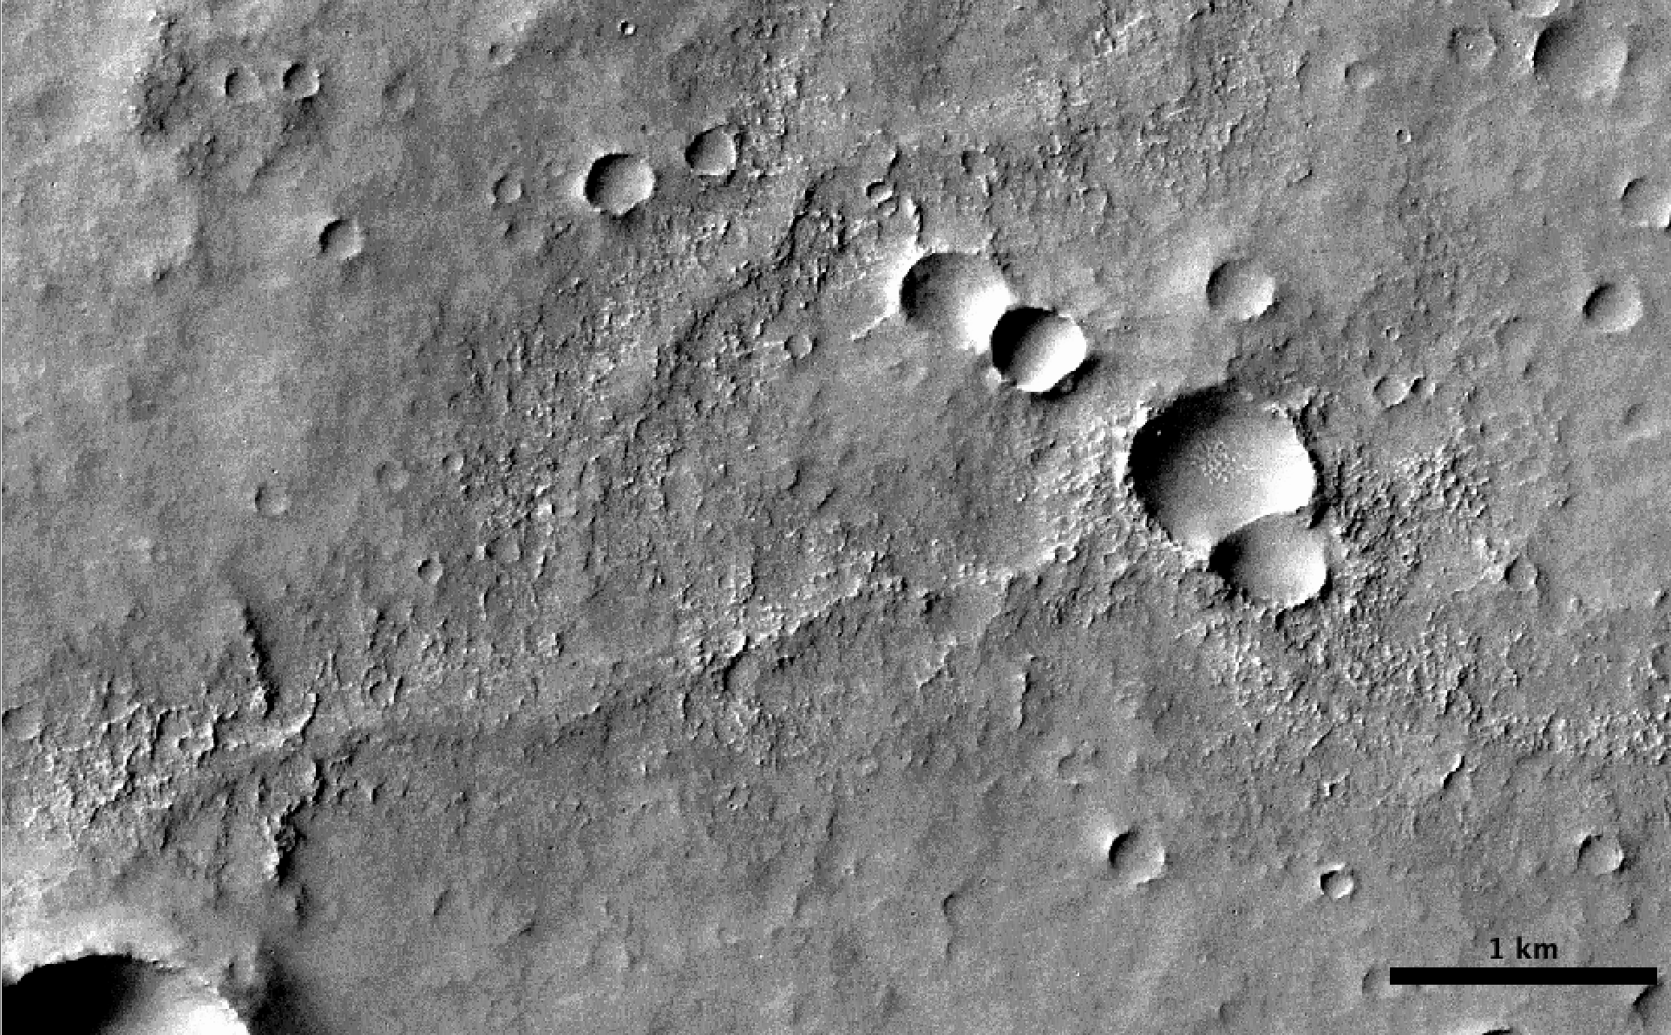

Slide 8
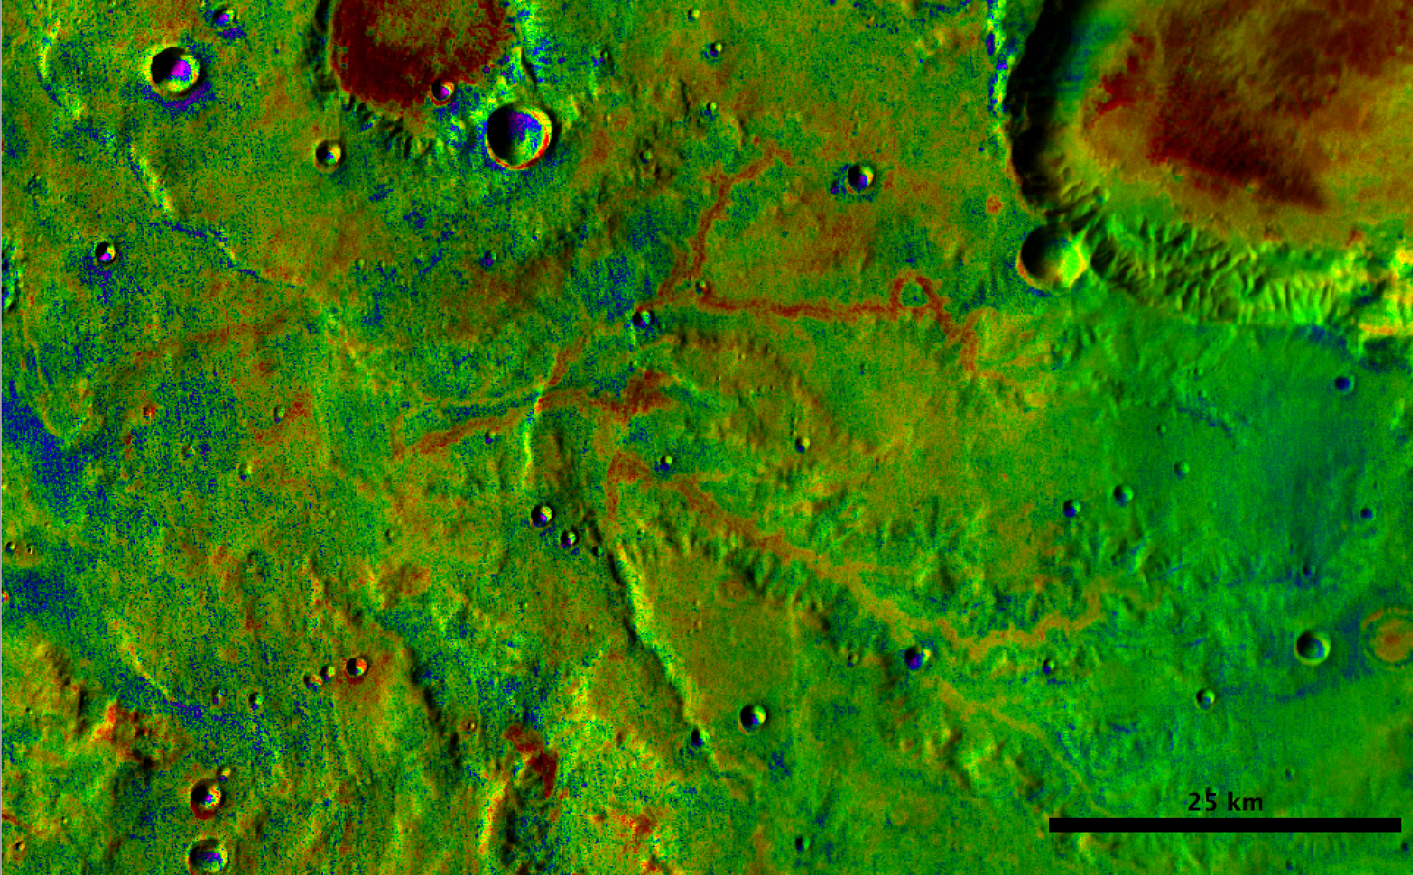

Slide 9
What We Know --- Future Work
Thermal Inertia
Scale
Composition
Stream Order
Sinuosity
Constrained Origin
  Lava Tube?
  Infilled Ancient Valley Network?

Slide 10

Acknowledgments

